Slide 1

Paso 2:Llena el Cuestionario Servicio Médico CECyT N°1 https://docs.google.com/forms/d/e/1FAIpQLScIT51OY0UECGCddMavr3qBZ6NR6_rKUmo3npzCKQzQ4RpWpA/viewform

Slide 2
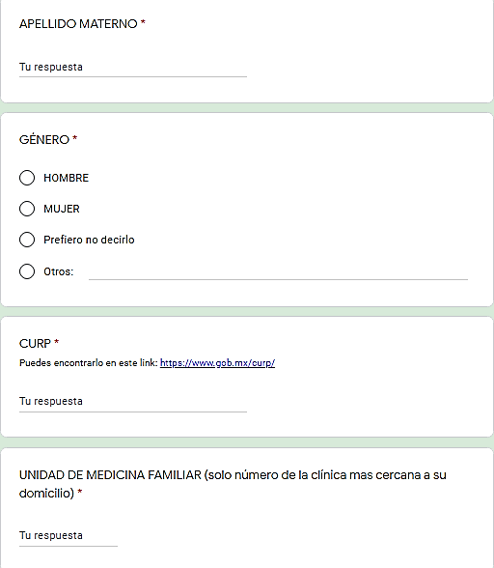
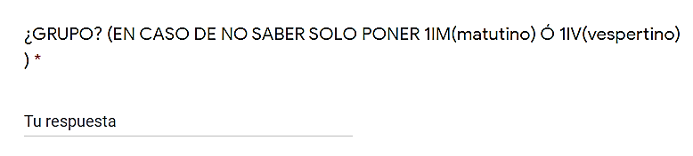
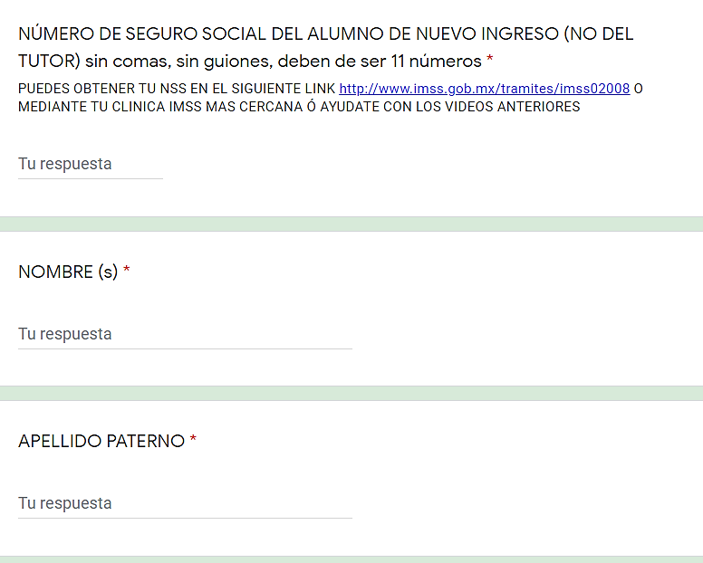

Slide 3
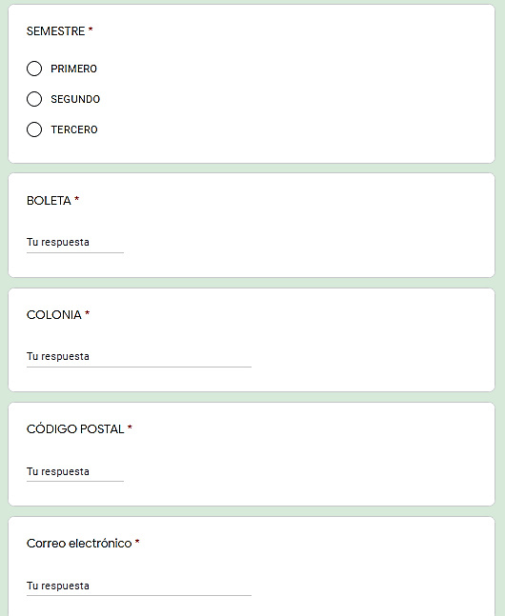
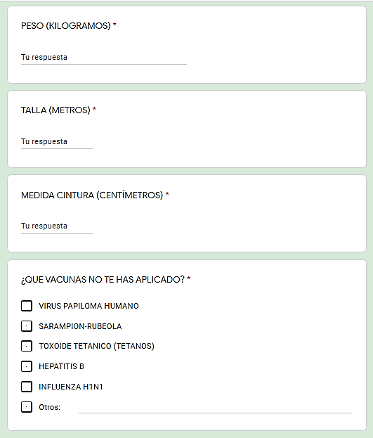

Slide 4
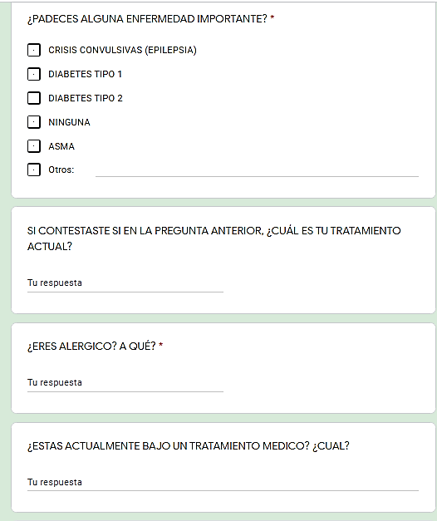
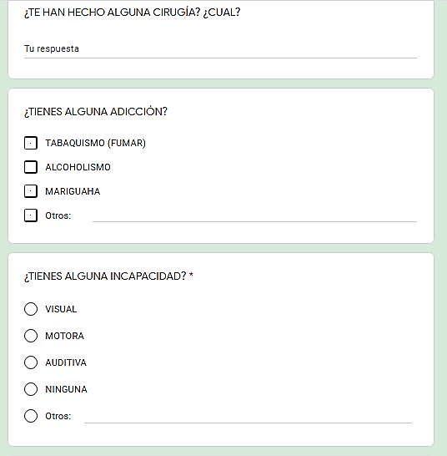

Slide 5
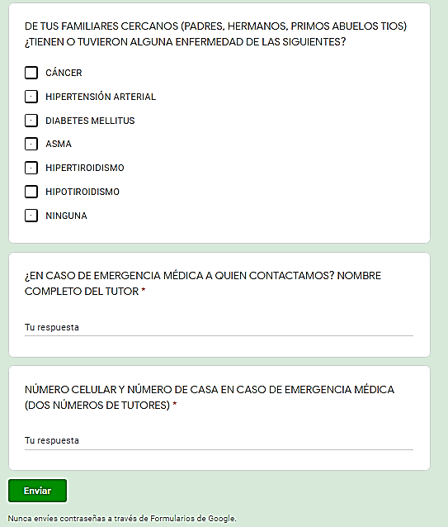
https://docs.google.com/forms/d/e/1FAIpQLScIT51OY0UECGCddMavr3qBZ6NR6_rKUmo3npzCKQzQ4RpWpA/viewform

